Slide 1
HCI Project
Title : Fun learning kid
Team
Madhu K S : PES1201802478
Chandrashekhara V Angadi : PES1201802491

Slide 2
Need Finding..
With the adoption of mobile/computer devices children are using computer technology at increasingly younger ages. Although they have become a potential end-user group for computer applications, the possibilities for early design evaluation methods are still being explored. Designing applications for 7 – 8 year old children who are interested in mobile or computer devices for their learning purpose is our main motivation

Slide 3
Low fidelity prototype..
To demonstrate how we are making a way to children to learn themselves in a fun way we are using STORY BOARDing method

Slide 4
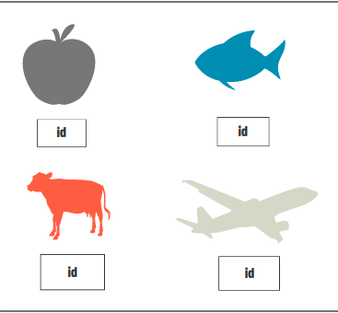
Initially we will dispaly all the objects with their id to the kid

Slide 5
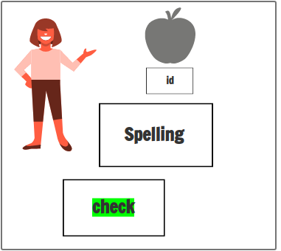
By looking at the image of the object kid has to enter its id and correct spelling and he has to click check button for its verification

Slide 6
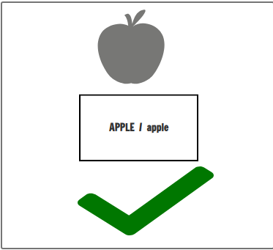
If kid enters correct spelling irrespective of case it will say its correct

Slide 7
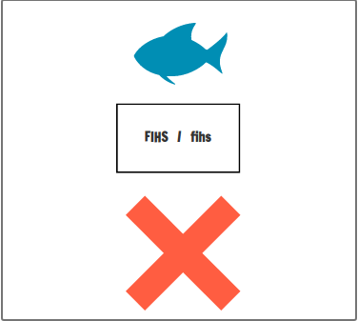
If kid enters wrong spelling it will say wrong

Slide 8
Technology used ..
HTML
CSS
JAVASCRIPT
PHP
DATABASE

Slide 9
Heuristic Evaluation..
Visibility of system status : System will show all the images and along with the ID of the image.
User control and freedom : Offers user to re enter the object name if it was wrong in first time
Consistency and standards : if one ID is representing one image then the same id cannot represent another image.

Slide 10
Heuristic Evaluation..
Recognition rather than recall : User just has to recognize the object present in the image.
Help and documentation : we can make a document which has some images or story board to tell kids how to paly game.

